Slide 1
Complement
Comenius University in Bratislava
Jessenius Faculty of Medicine in Martin
Department of Microbiology and Immunology
MUDr. Martina Neuschlová, PhD.
Supported by the project KEGA 038UK-4/2019 Ministry of Education, Slovak Republic

Slide 2
Click to select
Definition and synthesis
Main components
Biological effects
Complement activation pathways
The classical pathway
Determination of complement components
The alternative pathway
The mannose-binding lectin pathway
Determination of total complement activity
Membrane attack complex
START THE TEST

Slide 3
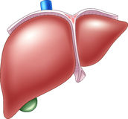
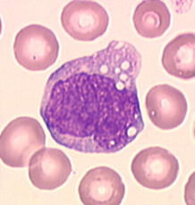
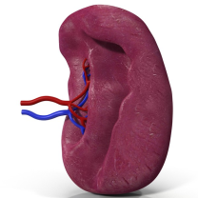
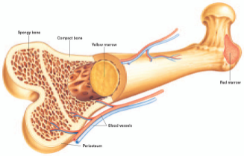
Complement
Complex of approximately 30 serum glycoproteins
One of the essential effector systems of innate non-specific humoral immunity
Synthesis is mainly:
  in the liver
  less in mononuclear phagocytes
  spleen
  bone marrow
GO BACK TO MENU
START THE TEST

Slide 4
The main components of complement
Serum proteins C1 to C9
They are activated step by step (cascade) by converting from:
that act on the other components of this cascade.
The central component of complement is glycoprotein C3, which is converted into fragments C3a and C3b. C3b fragment binds to the surface of microorganisms.
the inactive form
to the active enzymes
GO BACK TO MENU
START THE TEST

Slide 5
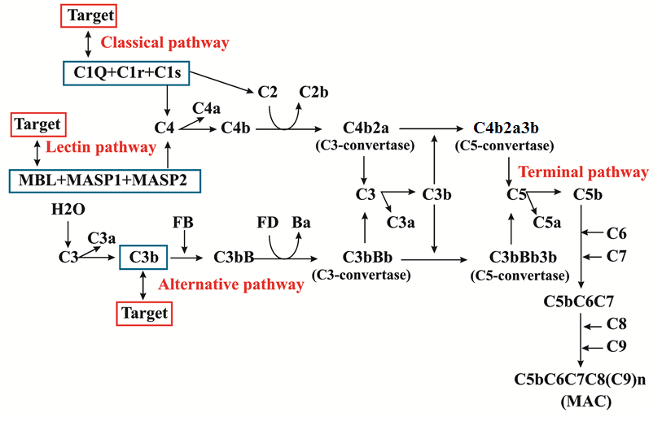
Complement activation pathways
Classical pathway
Lectin pathway
Terminal pathway
Alternative pathway
MAC
GO BACK TO MENU
START THE TEST

Slide 6
The classical complement pathway
begins with C1 activation
It is triggered by the binding of IgM or IgG antibodies to the antigen surface
Upon binding of the antibody to the antigen, a conformational change in the immunoglobulin molecule occurs and the binding site for the C1q complement component is uncovered. Activation occurs when C1q binds to these molecules, then the conformation of C1r and C1s, which become serine proteases, is altered to form an activated complex containing all of these – C1qrs components .
In the classic activation pathway, there is a time shift of 4-5 days.
GO BACK TO MENU
START THE TEST

Slide 7
The alternative complement pathway
triggered by external factors, especially of bacterial origin
evolutionarily the oldest, which reacts immediately upon entry of infectious microorganism
It can be activated by:
  components of bacterial cell walls of gram-positive and gram-negative bacteria (peptidoglycan, lipopolyssaccharides),
  bakterial exoproducts,
  fungal surfaces (zymosan),
  viruses and virus-infected cells,
  tumour cells,
  some parasites etc.
GO BACK TO MENU
START THE TEST

Slide 8
The mannose-binding lectin pathway
reacts immediately upon entry of infectious microorganism
the presence of antibodies is not required
the activator is not an antibody but serum lectin – mannose-binding lectin (MBL) = an acute phase inflammatory protein that increases furing inflammation
MBL binds mannose, which is a typical surface component of many microorganisms
upon binding of MBL to the microorganisms, the MASP-1 and MASP-2 proteinases bind to it, thereby forming a complex similar to C1qrs, and a cascade of activation may continue as in the classical pathway
GO BACK TO MENU
START THE TEST

Slide 9
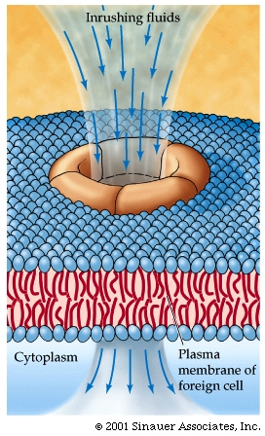
Membrane attack complex
The result of this cascade is massive amplification of the response and activation of the cell-killing membrane attack complex (MAC) and lysis of the target cell
GO BACK TO MENU
START THE TEST

Slide 10
Biological effects of complement
Great importance in the defence of the body, especially against infection
Individual components of complement have various properties:
  chemotaxins,
  opsonins,
  They regulate the process of phagocytosis and inflammatory reaction,
  induce histamine release,
  participate in lysis of microorganisms, in the release of biologically active substances,
  promote the solubilization of immune complexes and their clearance by phagocytes
GO BACK TO MENU
START THE TEST

Slide 11
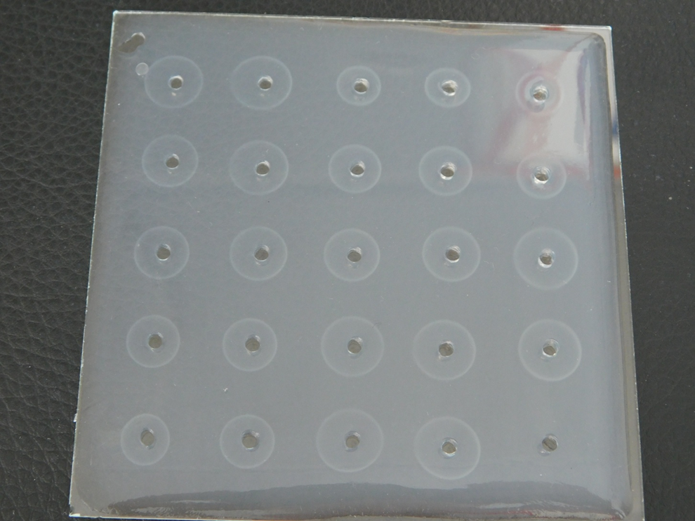
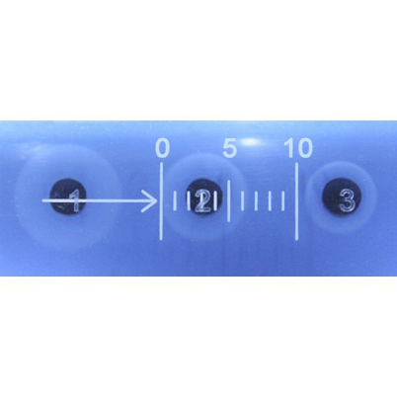
Determination of complement components
In practice, most commonly two key complement components C3 and C4 are usually determined
Single radial immunodiffusion is used to quantify C3 and C4 concentration
In this assay, the zone of precipitation is formed
The diameter of the zone of precipitation is directly proportional to the concentration of C3 (or C4)
GO BACK TO MENU
START THE TEST

Slide 12
Determination of total complement activity
Total complement activity (or CH50 Blood test) is often ordered to evaluate the integrity of the complement system and evaluates the classical complement activation pathway. If an alternative component defect is suspected, an AH50 test may be performed.
test CH50 – screening test assesses the overall activity of the complement system
Values are reported in hemolytic units:
One hemolytic unit determines the amount of complement that is able to lyse 50% of standard concentration of sensitized sheep erythrocytes.
A total complement measurement, also known as a total hemolytic complement or a CH50 measurement, checks how well the complement system is functioning.
GO BACK TO MENU
START THE TEST

Slide 13
Try the test – complement
Click on the correct answer
IF YOU MARK THE CORRECT ANSWER, THE ANSWER WILL CHANGE ITS COLOUR TO YELLOW
If you mark the wrong answer, the answer will change its colour to red
GO BACK TO MENU

Slide 14
Rapid activation of complement after the 1st exposition to antigen is usually done by:
Alternative pathway and mannose-binding lectin pathway
Classical pathway

Slide 15
CH50 is a blood test to detect:
Complement activity and evaluation of components C3 and C4, which are responsible for defects in alternative pathway of complement activation
Total complement activity to evaluate the integrity of complement system

Slide 16
CH50 is a screening test to detect, how well the complement system is functioning and is the integral part of:
Non-specific cellular immunity
Non-specific humoral immunity
Specific cellular immunity
Specific humoral immunity

Slide 17
Principle of detection of C3 and C4 component of complement:
Cultivation
Single radial immunodiffusion – Mancini
Double radial immunodiffusion
Agglutination
All answers are correct

Slide 18
The membrane attack complex consists of:
OH
C3-convertase
C3b3bBb
C5b,6,7,8,9(n)
Properdin

Slide 19
C3b component of complement:
Is a chemotaxin
Opsonizes bacteria
Is an anaphylatoxin
Directly injures bacteria
Is the inactive form of C3 component

Slide 20

C4b2a
Is a main component of membrane attack complex
Is a part of alternative pathway of complement activation
Is C3-convertase
Causes lysis of cells

Slide 21
The classical complement activation pathway is triggered
Immediately by components of bacterial cell walls of gram-positive bacteria
Immediately by components of bacterial cell walls of gram-negative bacteria
By the serum mannose-binding lectin
By the binding of IgM or IgG antibodies to the antigen surface

Slide 22
The alternative complement activation pathway is triggered
By the binding of C3 component of complement
Immediately by components of bacterial cell walls of gram-positive or gram-negative bacteria (peptidoglycan, lipopolysaccharides)
By the binding of pentamer imunoglobulin IgM to the antigen surface
By the binding of monomer imunoglobulin IgG to the antigen surface

Slide 23

The central component of complement is:
C1
C2
C3
MAC

Slide 24
Are you satisfied with your results?
You can try the test again
OR
GO TO THE HOME PAGE AND REPEAT THE INFORMATION ON COMPLEMENT
GO BACK TO MENU
START THE TEST

Slide 25
References
Neuschlová M, Nováková E, Kompaníková J. Návody na praktické cvičenia z imunológie. Multimediálna podpora výučby klinických a zdravotníckych disciplín: Portál Jesseniovej lekárskej fakulty UK v Martine [online]. 2016 [cit. 2016-11-01]. Dostupné na internete: <https://portal.jfmed.uniba.sk/clanky.php?aid=348>. ISSN 1337-7396.
Neuschlová M, Nováková E, Kompaníková J. Abeceda imunológie – terminologický slovník. Multimediálna podpora výučby klinických a zdravotníckych disciplín: Portál Jesseniovej lekárskej fakulty UK v Martine [online]. 2016 [cit. 2016-11-02]. Dostupné na internete: <https://portal.jfmed.uniba.sk/clanky.php?aid=344>. ISSN 1337-7396.
https://www.dreamstime.com/stock-illustration-human-liver-anatomy-structure-realistic-indicators-text-captions-front-back-image58429827
http://anatomybody101.com/tag/human-body-spleen/
http://www.svt.ac-versailles.fr/IMG/jpg/monocyt.jpg
https://fbresearch.org/leukemia-improving-efficiency-of-bone-marrow-transplants/
http://www.intechopen.com/source/html/43780/media/image1.jpeg
http://course1.winona.edu/kbates/bio241/immunolo.htm
http://www.idbiotech.com/rid-srid-kit-test-radial-immunodiffusion/57-horse-igg-idr-rid.html
https://www.walkinlab.com/products/view/complement-total-ch50-blood-test

