Slide 1


New methods in immunology
Comenius University in Bratislava
Jessenius Faculty of Medicine in Martin
Department of Microbiology and Immunology
MUDr. Martina Neuschlová, PhD.
Supported by the project KEGA 038UK-4/2019 Ministry of Education, Slovak Republic

Slide 2
Click to select
Immunofluorescency
Immunoblotting methods
Chemiluminescent and fluorescence immunoassay
PCR
Radioimmunoassay
ELISpot
Immunoanalytical methods
Enzyme immunoassay
ELISA
START THE TEST
CONTINUE

Slide 3
IMMUNOFLUORESCENCY
it is a technique that utilizes fluorophores (fluorochromes) to visualize various cellular antigens such as proteins
it can be utilized to visualize the localization of various cellular components within cells or tissues
fluorophores are essential for immunofluorescence
they emit light when exposed to a certain wavelength of light
one of the best-known fluorochromes is fluorescein isothiocyanate (FITC) or cyanine dye

Slide 4
the biological sample of interest is incubated with an antibody specific to the antigen of interest
immunofluorescence is known in two modifications:
direct and indirect
The antibody is directly conjugated to a fluorochrome.
Uses a single antibody directed against the target antigen.
The antibody is detected by a secondary antibody conjugated to a fluorochrome.
Uses two antibodies.

Slide 5
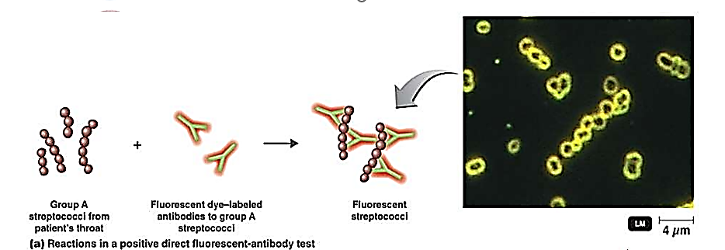
Direct immunofluorescence
involves the exclusive use of antibodies that have been coupled with fluorochromes
the detected antigen may be found in tissue, body fluid, cell culture...
specimen is incubated with the fluorochrome-labelled antibody, the unbound antibody is removed by washing, and the specimen is examined

Slide 6
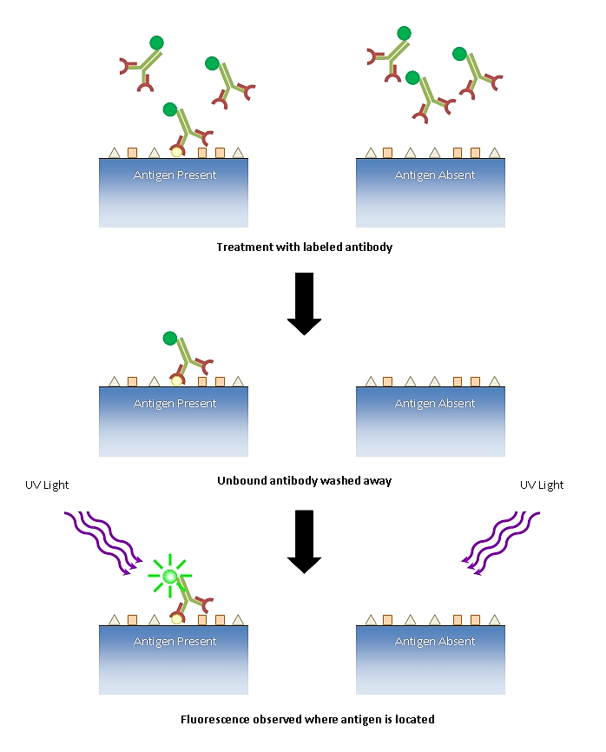
Procedure
test sample must be fixed in a thin layer on a slide
specific fluorochrome-labelled antibody is then applied to the surface of the preparation thus prepared
if the antigen is present in the sample, it will bind to the antibodies during incubation
subsequent washing removes excess unbound antibodies
after incubation and washing, the preparation is then evaluated in a fluorescence microscope

Slide 7
Result
positive result is manifested by fluorescence at sites where the antigen is present
if fluorochrome FITC is used, the fluorescence is yellow-green
direct immunofluorescence is mainly used for the detection of antigens in tissue sections, for the rapid detection of pathogens in sputum, swabs, etc.
direct immunofluorescence is not often used now, as it would involve making a range of differently labelled antibodies for every protein studied in laboratories
in addition, the sensitivity of the technique is low, as there is only one label for each binding site

Slide 8
Indirect immunofluorescence
is preferable in many cases
the specimen is incubated with an unconjugated antibody (primary antibody), then washed and incubated with a fluorochrome-conjugated anti-immunoglobulin antibody
this second antibody reveals the presence of the first
positive result is shown by fluorescence when examined under a fluorescence microscope

Slide 9
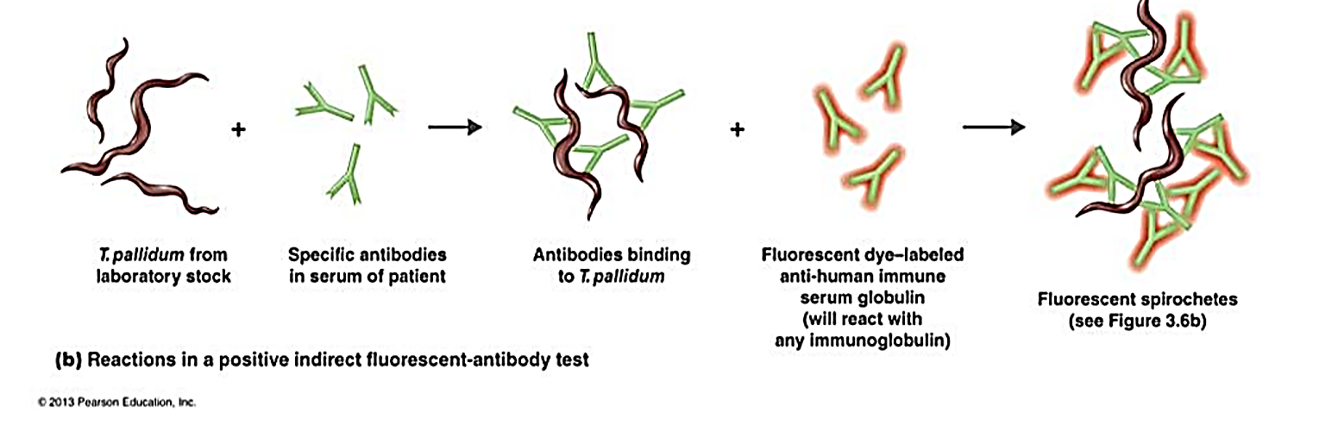
indirect immunofluorescence is used more frequently to detect antibodies in serum

Slide 10
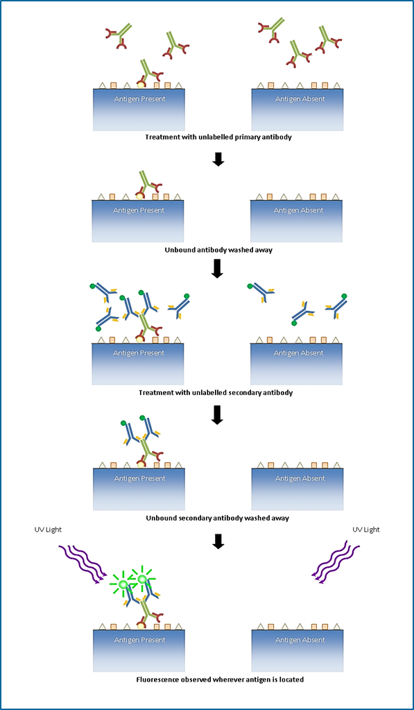
Procedure
in this case, the preparation is prepared from healthy tissue, cell or bacterial culture
patient sample tested for the presence of antibodies is applied to this preparation
after the first incubation and washing, a fluorochrome-labelled secondary antibody is added
after the second incubation and washing, the preparation is viewed under a fluorescence microscope

Slide 11
Result
positive reaction is manifested by the fluorescence of antigen-containing structures against which antibodies have been present in the patient's serum
this method is most commonly used to determine anti-infective antibodies and autoantibodies in both organ-specific and systemic autoimmune diseases
for example, the presence of antinuclear antibodies in the examined serum is reflected by the fluorescence of nuclear structures in cells
GO BACK TO THE HOME PAGE

Slide 12
IMMUNOANALYTICAL METHODS
are modern bioanalytical methods in which quantitation of analyte depends on the reaction of an antigen with a specific antibody
they make it possible to determine low concentrations of antigens or antibodies, which usually cannot be determined by classical serological methods
also can be used to determine small amounts of various hormones, cytokines, tumor markers, etc.
they have been widely used in many important areas of analysis such as diagnosis of diseases, therapeutic drug monitoring, clinical pharmacokinetics and bioequivalence studies in drug discovery and pharmaceutical industries

Slide 13
enzymes (enzyme immunoassay)
radioactive atoms (radioimmunoassay)
chemiluminescent substances (chemiluminescent immunoassay)
fluorescent probes (fluorescence immunoassay)

Slide 14
Enzyme immunoassay – EIA
they can be used for the detection of antigens or antibodies in serum and other body fluids of the patient
in EIA techniques, antigens or antibodies labelled with enzymes are used
enzymes:
  alkaline phosphatase
  horseradish peroxidase
  β-galactosidase
GO BACK TO THE HOME PAGE

Slide 15
ELISA (Enzyme-Linked ImmunoSorbent Assay)
ELISA is currently one of the most common immune assays used in clinical and experimental procedures
there are different types available for the detection and quantitation of either the antigen or antibodies in serum and other body fluids
each type of ELISA has its own advantages and disadvantages

Slide 16
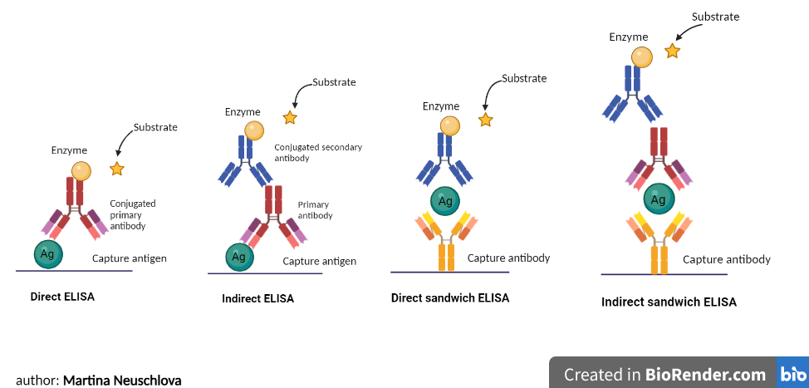
there are 4 main types of ELISA tests
direct
indirect
sandwich
competitive

Slide 17
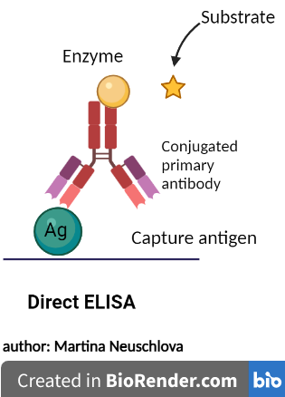
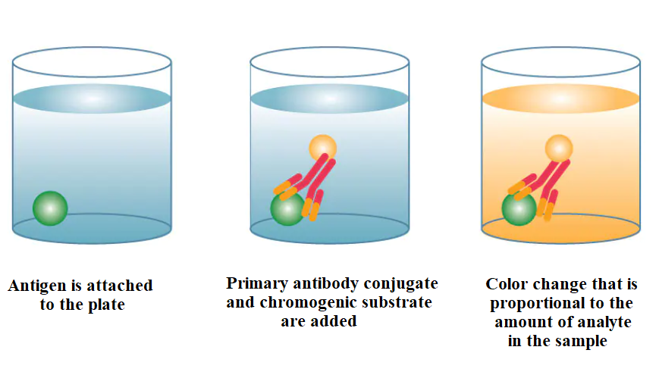
Direct ELISA
is used mostly for antigen detection
antigen is attached to the plate and enzyme-labelled antibody (conjugated primary antibody) is added that can react with the antigen
substrate is then added, producing a signal (color change) that is proportional to the amount of analyte in the sample
Advantages: fast and simple protocol, no cross-reactivity from secondary antibody.
Disadvantages: low flexibility – the primary antibody must be conjugated, no signal amplification.

Slide 18
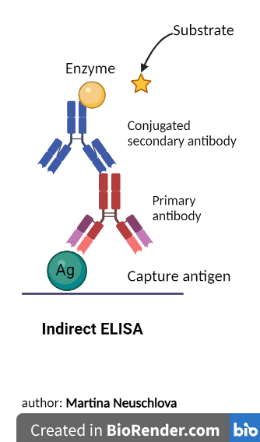
Indirect ELISA
is used mainly for antibodies detection
technique that uses a two-step process for detection
is similar to a direct ELISA in that an antigen is adsorbed on a plate, but it includes an additional amplification detection step
unconjugated primary detection antibody is added and binds to the specific antigen
conjugated secondary antibody (enzyme-labelled antibody) directed against the host species of the primary antibody is then added (amplification)
chromogenic substrate is added that produces a signal (color change) proportional to the amount of determined antibody bound in the well

Slide 19
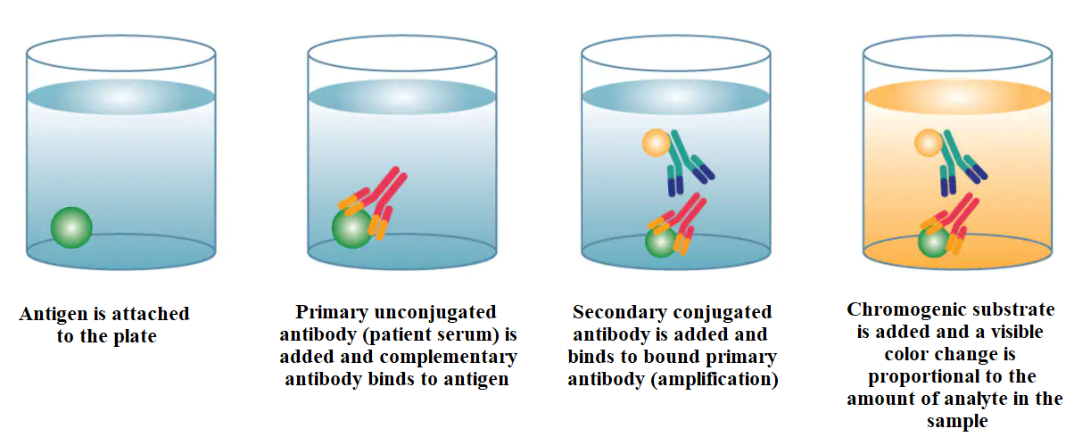
Advantages: amplification using a secondary antibody, several secondary antibodies will bind to the primary, high flexibility: the same secondary antibody may be used for several primary antibodies.
Disadvantages: longer protocol if compared to direct ELISA, potential for cross-reactivity caused by secondary antibody.

Slide 20
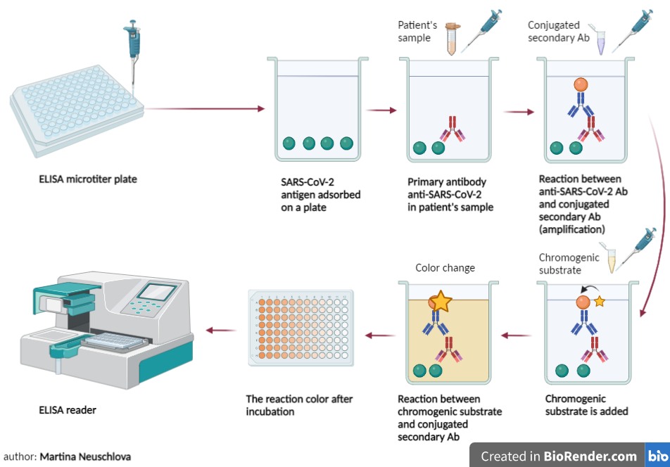
Application of indirect ELISA – example for anti-SARS-CoV-2 antibodies detection
coated SARS-CoV-2 antigen onto wells on a plate interacts with the primary antibody (anti-SARS-CoV-2 antibody) that can be in a patient's sample
after adding a conjugated secondary antibody (enzyme-labelled antibody), it recognizes and interacts with the primary antibodies (amplification)
chromogenic substrate is then added and is cleaved by the enzyme and results in color change after incubation
result is read by ELISA plate reader

Slide 21
Sandwich ELISA
the most common type
quantify antigens between two layers of antibodies (i.e. capture and detection antibody).
this assay uses two different antibodies that are reactive with different epitopes on the antigen
the antigen to be measured must contain at least two antigenic epitopes capable of binding to antibody since at least two antibodies act in the sandwich

Slide 22
monoclonal or polyclonal antibodies can be used as the capture and detection antibodies
the procedure for a sandwich ELISA requires the well of an ELISA plate to be coated with a capture antibody
the analyte or sample is then added, followed by the detection antibody
according to the detection principle and whether to use the enzyme-labelled capture antibody, sandwich ELISA could be divided into direct sandwich ELISA and indirect sandwich ELISA

Slide 23
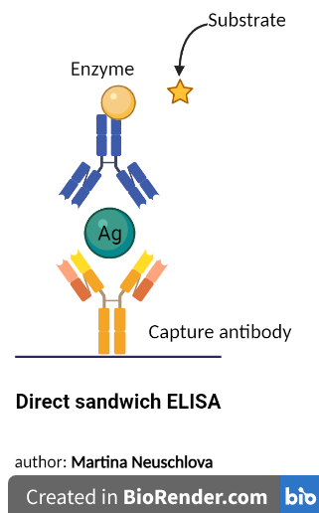
Direct sandwich ELISA
the capture antibody is coated on a plate
test solutions containing antigen are added to the wells on the plate and allowed to bind
conjugated-detection antibody (enzyme-labelled antibody) is then added and binds to an additional epitope on the target antigen
chromogenic substrate is then added and produces a signal (color change) that is proportional to the amount of analyte present in the sample

Slide 24
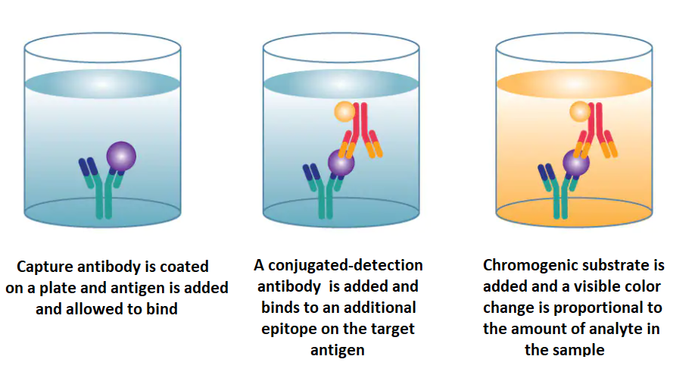
Direct sandwich ELISA – the detection antibody is enzyme-conjugated

Slide 25
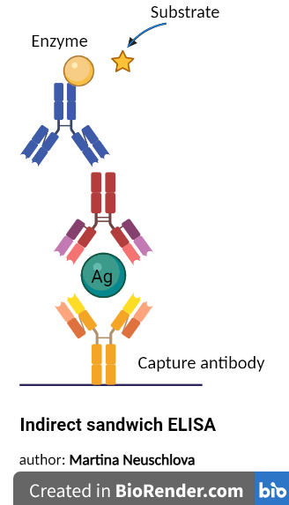
Indirect sandwich ELISA
the primary antibody is unlabeled and a secondary detection antibody is enzyme-conjugated
sandwich ELISAs are highly specific since two antibodies are required to bind to the protein of interest
Advantages: high specificity: the antigen is specifically captured and detected, high flexibility: both direct and indirect methods can be used and high sensitivity: more sensitive than direct or indirect ELISA.
Disadvantages: longer protocol, challenging to develop two antibodies against the same antigen that recognize different epitopes and work together

Slide 26
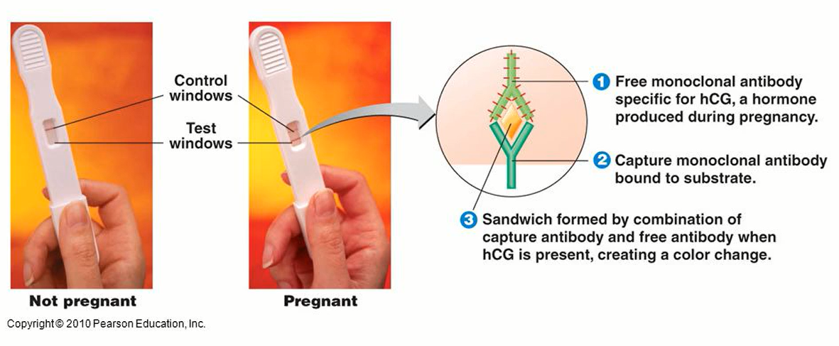
Application of sandwich ELISA
Home pregnancy test utilizes the principle of sandwich enzyme immunoassay, with a unique monoclonal antibody combination specific against hCG present in urine.
The patient's urine specimen is allowed to react with the monoclonal antibody (capture antibody) directed against hCG and the monoclonal conjugated-detection antibody (enzyme-labelled antibody).
If hCG is present in the test specimen, an antibody-hCG-antibody enzyme complex will be formed, which results in the development of color change.
GO BACK TO THE HOME PAGE

Slide 27
Competitive ELISA
also known as inhibition ELISA measure the concentration of an antigen by detection of signal interference
the sample antigen competes with a reference antigen for binding to a specific amount of labelled antibody
depending on the amount of antigen in the sample, more or less free antibodies will be available to bind the reference antigen in the wells
this means the more antigen is in the sample, the less reference antigen will be detected and the weaker the signal
GO BACK TO THE HOME PAGE

Slide 28
Radioimmunoassay – RIA
in vitro immunoassay that measures usually the presence of an antigen present in the sample
radioisotopes (usually 125I, 131I ) are used instead of enzymes as labels to be conjugated with antigens
the classical radioimmunoassay methods are based on competitive binding
an unlabeled antigen competes with a radiolabeled antigen for binding to an antibody with the appropriate specificity
then the radioactivity of the free antigens is measured
RIA is characterized by high sensitivity and specificity
allows determining biologically important substances in nano- and pictogram concentrations
GO BACK TO THE HOME PAGE

Slide 29
Chemiluminescent immunoassay
uses luminophore markers as a label - substances that emit light during oxidation
light is emitted during the chemical reaction and is detected by a luminometer
Fluorescence immunoassay
uses fluorochrome as a label and signal detection is done fluorimetrically
the principles of both methods are identical to the methods in enzyme-linked immunosorbent assays and are described above
GO BACK TO THE HOME PAGE

Slide 30
IMMUNOBLOTING TECHNIQUES
blotting methods combine electrophoresis and immunoassay
they take place in various modifications
Western blot and immunodot are most commonly used
DNA analysis (Southern blot)
RNA analysis (Northern blot)
protein analysis (Western blot)
Eastern blot to analyze post-translational modifications
they can be used for:

Slide 31
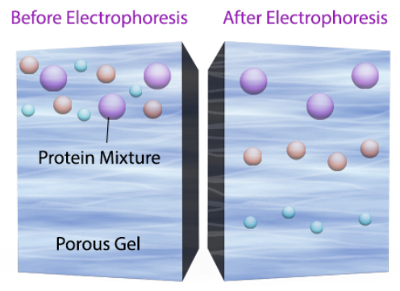
Western blot
in this technique, a mixture of proteins is separated based on molecular weight through gel electrophoresis
then transferred to a blotting membrane producing a band for each protein
then incubated with an antibody, which specifically binds to the protein of interest and with secondary antibody
the secondary antibody is linked to an enzyme that produces color or light, which allows it to be easily detected and imaged

Slide 32
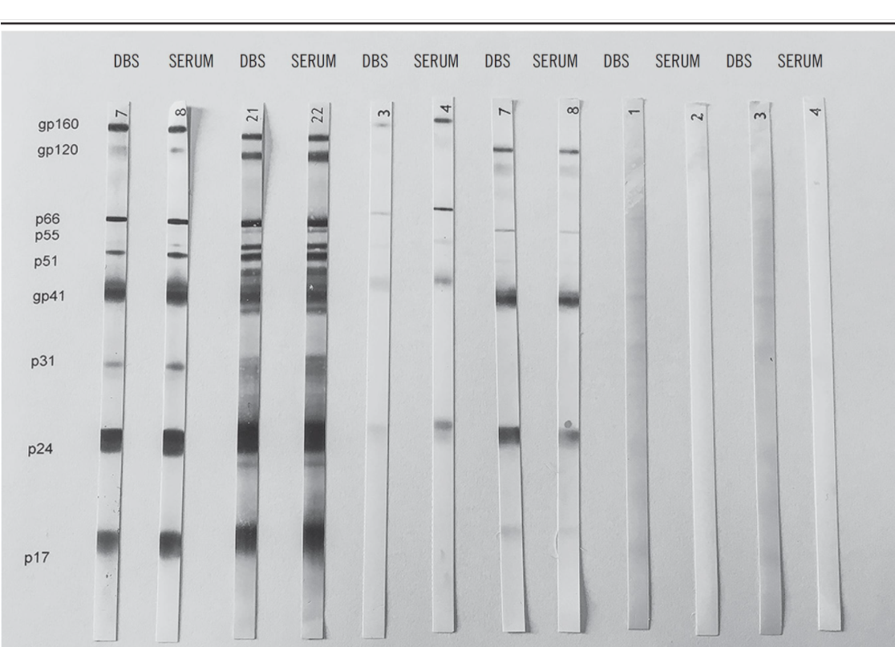
Western blot - result
the thickness of the band corresponds to the amount of protein of interest

Slide 33
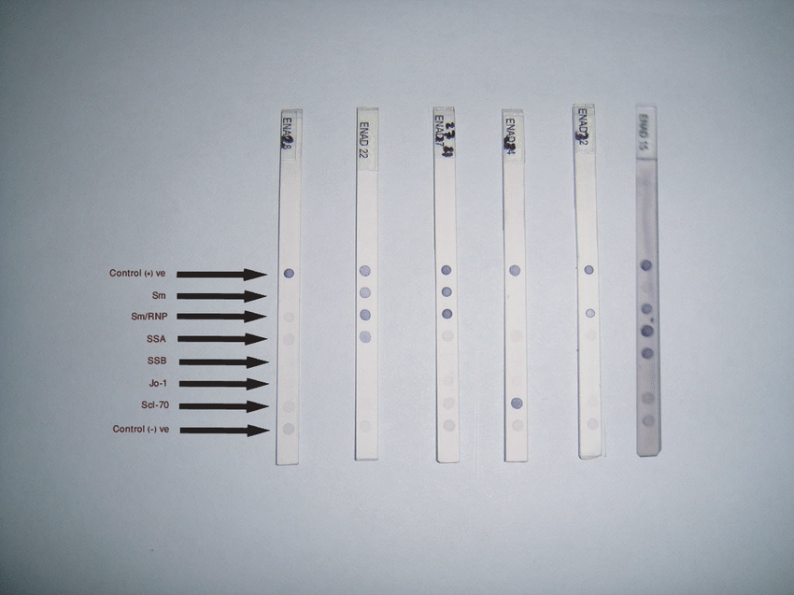
Immunodot
is a simple and rapid assay that utilizes an enzyme-linked immunoassay dot technique for the detection of antibodies
the antigens are dispensed as discrete dots onto a solid membrane
reading immunodotes is easier, but tests are more expensive

Slide 34
Application of immunoblotting techniques
the advantage of blotting techniques is the ability to detect several specific antibodies against individual antigens at once
blotting methods are currently widely used due to their high sensitivity and specificity
these assays are used as confirmatory assays to determine specific antibodies against infectious agents
GO BACK TO THE HOME PAGE

Slide 35
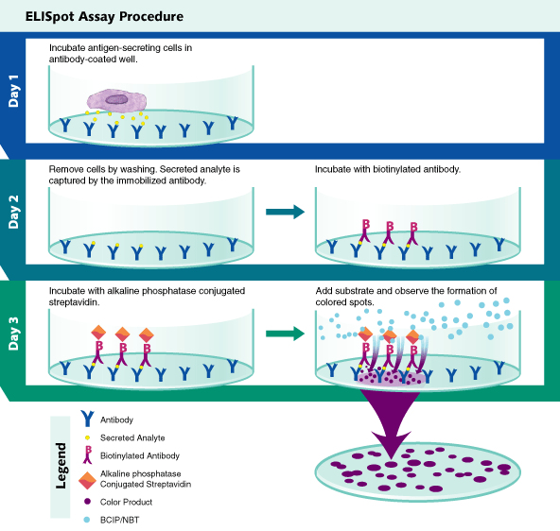
ELISpot (Enzyme-Linked ImmunoSpot assay)
cells are cultured on a surface coated with a specific capture antibody
cytokines, that are secreted by the cells will be captured by the specific antibodies on the surface
the secreted molecules are detected using a similar procedure to that employed by the ELISA
Result: visible spots on the surface
each spot corresponds to an individual cytokine-secreting cell
highly sensitive method for quantification of the number of cytokines secreting cells

Slide 36
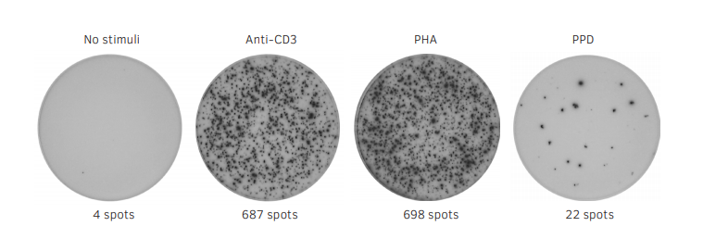
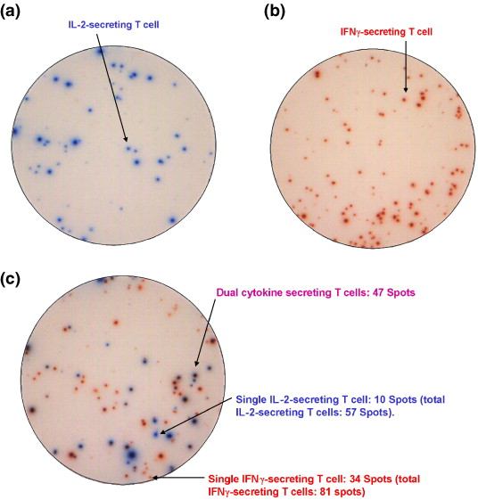
Result: a spot is created at the bottom of the well at the site where the cell (e.g. T cell) produced the cytokine
Analysis: intensity and size of spots depends on the amount of cytokine released by the cell
each spot = corresponds to an individual cytokine-secreting cell
number of spots = number of cytokine-secreting cells
Application: T-spot test for tuberculosis by measuring IFN-gamma secretion from T cells responding to antigens from Mycobacterium tuberculosis
GO BACK TO THE HOME PAGE

Slide 37
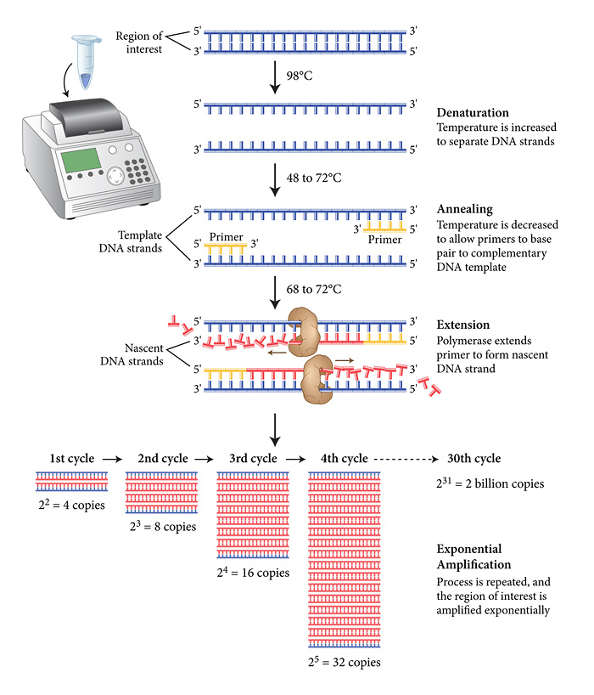
PCR – Polymerase Chain Reaction
PCR is divided into three stages:
  denaturation,
  hybridization (annealing)
  extension
these steps are repeated (“cycled”) in a thermal cycler to exponentially produce exact copies of the target DNA
the detection and analysis of the products can be very quickly carried out by agarose gel electrophoresis or acrylamide gel electrophoresis, or by fluorescence
GO BACK TO THE HOME PAGE

Slide 38
Questions for self-assessment
Click on the correct answer
IF YOU MARK THE CORRECT ANSWER, THE ANSWER WILL INCREASE!
If you mark the wrong answer, the answer will disappear.
GO BACK TO THE HOME PAGE

Slide 39
A/An __________ is a disease-fighting protein created by the immune system in response to the presence of a specific antigen.
antigen
complement
antibody
immunogen

Slide 40
A/An __________ is any substance that the body regards as being foreign and includes viruses, bacteria, toxins, and transplanted tissues.
antigen
interferon
tolerogen
cytokine

Slide 41
Immunologic technique - to detect antigen or antibody specificity of the antibody-antigen interaction is:
Rosette test
Phagocytosis activity
Bactericidal activity of sera
Serological reaction

Slide 42
By ___________ is used conjugate (antibodies to the Ag-Ab complex) labeled by ensyme.
RIA
ELISA
PCR
Latex agglutination

Slide 43
Similar principle to ELISA, but conjugate is labeled by radioactive material (iodine-125) is:
RIA
Western blot
Immunofluorescence
Immunodot

Slide 44
Immunofluorescence analysis uses conjugate labeled by:
Radionuclid
Ensyme
Fluorochrome
Natrium fluorid

Slide 45
By ________________ antigen is divided by electrophoresis to separate antigens, next steps are identical as in ELISA.
Direct immunofluorescence
Western blot
ELISpot
Sandwich ELISA

Slide 46
What is the test used to verify Hepatitis C – borderline positive test results obtained by ELISA?
Western blot
Mancini test
Precipitation – ring test
Immunoelectro-phoresis

Slide 47
Which of the following radioactive element is generally involved in RIA?
alkaline phosphatase
peroxidase
iodine-125
streptavidine

Slide 48
Antibody titer refers to the:
Affinity of specific antibody
Avidity of specific antibody
Absolute amount of specific antibody
Highest dilution of antibody still able to give a positive result in a test system

Slide 49
Latex particles are often used in:
Affinity chromatography
Adjuvants
Agglutination tests
Neutralization assays

Slide 50
Western blots are primarily used to detect:
Carbohydrate
Protein
RNA
DNA

Slide 51
Which of the following is not used as a direct conjugate to the antibody for visualizing tissue antigens:
Anti-immunoglobulin
Fluorescein
Alkaline phosphatase
Peroxidase

Slide 52
In an ELISA you might use an antigen or antibody labeled with:
¹²⁵I
Latex
Fluorochrome FITC
Horseradish peroxidase

Slide 53
Antigens in tissues can be localized with fluorescent antibodies using:
Flow cytofluorimetry
A confocal fluorescence microscope
An enzyme substrate
The electron microscope

Slide 54
Are you satisfied with your results?
You can try the test again
OR
GO TO THE HOME PAGE AND REPEAT THE INFORMATION
GO BACK TO THE HOME PAGE
START THE TEST

Slide 55
References
Boulet S. et al. A dual color ELISPOT method for the simultaneous detection of IL-2 and IFN-gamma HIV-specific immune responses. J Immunol Methods 2007; 30: 320 (1-2): 18-29.
Sharmin S. et al. Evaluation of Dot Immunoblot for identification of antibodies to Extractable nuclear antigen. 2011. [online]. [cit. 19.11.2021]. Available on: https://www.researchgate.net/figure/Dot-Blot-strips-Strip1-negative-Strip-2-Anti-Sm-RNP-SSA-positive-Strip-3-Anti-Sm-RNP_fig1_273263071
Neuschlová M, Nováková E, Kompaníková J. Imunológia – ako pracuje imunitný systém. Jesseniova lekárska fakulta v Martine Univerzity Komenského v Bratislave 2017; s. 189. ISBN 978-80-8187-031-6.
Neuschlová M, Nováková E, Kompaníková J. Návody na praktické cvičenia z imunológie. Jesseniova lekárska fakulta v Martine Univerzity Komenského v Bratislave 2016; s. 114. ISBN 978-80-8187-017-0.
https://di.uq.edu.au/community-and-alumni/sparq-ed/cell-and-molecular-biology-experiences/immunofluorescence/background-immunofluorescence
https://encrypted-tbn0.gstatic.com/images?q=tbn:ANd9GcTYEmjUn2be0G6vLTd0p2gjNMARLOjLatYnLw&usqp=CAU
https://www.rndsystems.com/resources/what-is-an-elisa-and-elisa-types
https://slideplayer.com/slide/4937003/63/video/Practical+Applications+of+Immunology.mp4
https://www.biolegend.com/fr-ch/western-blot
https://www.scielo.br/j/jbpml/a/LmqFQqSms3CXGkWPbBGCBwD/?lang=en
https://www.rndsystems.com/products/elispot-assay-principle
https://www.mabtech.com/sites/default/files/elispot-brochure.pdf
https://www.roitt.com/mcqlist.asp
https://www.neb.com/~/media/NebUs/Page%20Images/Applications/DNA%20Amplification%20and%20PCR/pcr.jpg

